Slide 1
SOP, CORS & CSP
What, Why & How
- Sagar Bhavar

Slide 2
Agenda
What, Why and How – SOP, CORS & CSP
Security Applications
Implementations
Security Concerns
Mitigations
Examples
References

Slide 3
SOP
Same Origin Policy

Slide 4
SOP – Same Origin Policy
Created in 1995 by Netscape Navigator
Most important web Security Policy
Restriction policy on the resources interaction
To restrict the cross-site issues with origin
Its all about origin

Slide 5
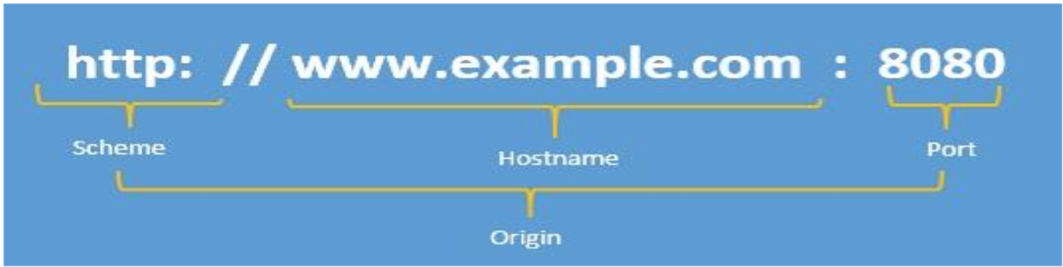
Origin
Same Origin – URI Scheme, Host and port number ( If one of the port is specified & Excluding IE) for the both pages

Slide 6
Example – Origin comparison
http://merchant.store.com/folder/page.html
URL | Outcome | Reason
http://merchant.store.com/folder2/other.html | Success | -
http://merchant.store.com/folder/inner/another.html | Success | -
https://merchant.store.com/secure.html | Failure | Protocol mismatch
http://merchant.store.com:81/folder/etc.html | Failure | Port mismatch
http://products.store.com/folder/other.html | Failure | Host mismatch

Slide 7
Common Misconception
“SOP means that one page cannot send data to a different server” – WRONG !
“SOP means that one page cannot use resources from a different server” – WRONG !
“SOP means that pages from one site are completely immune to tampering by other sites” – Again WRONG !

Slide 8
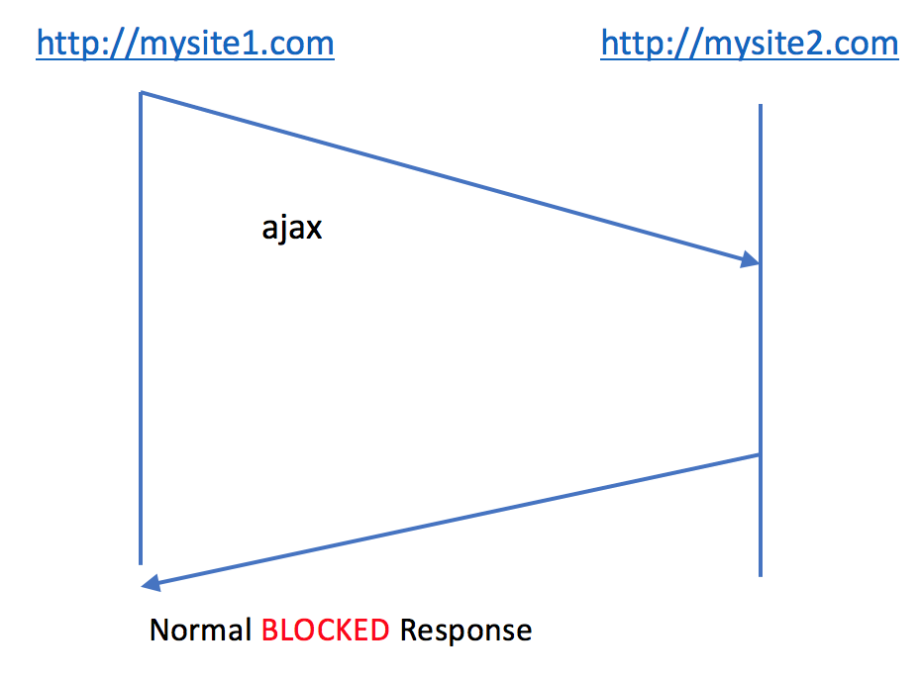
Blocking SOP for GET Request

Slide 9
Demo – Example
        Demo

Slide 10
Same origin policy for accessing DOM
A webpage inside the frame is not allowed to modify or access the DOM of its parent and vice-versa
  Bypasses
    window.document.domain
    Proxy
    Cross Document Messaging

Slide 11
Same Origin Policy for AJAX
A webpage cannot make a AJAX Request to an another page if they both don’t belong to SOP.
- Bypasses
        Proxy server
        JSONP
        Cross-Origin Resource Sharing

Slide 12
Same Origin Policy for Cookies
For example –
www.example.com can set a cookie for example.com
www.blog.example.com can set cookies for blog.example.com and example.com.
blog.example.com cannot set cookie for news.example.com because news.example.com is not a parent of blog.example.com
  Allowed for sub-domains and denied for different public suffixes

Slide 13
Same Origin Policy for data storage
Data stored in the browser (inside localStorage and IndexedDB) are allowed to be accessed only from the same origin
Two webpages (parent and frame) from different origins can access each other’s local storage by using Cross Document Messaging API or window.name variable

Slide 14
Security Applications
Critical security mechanism - Isolation of potential malicious documents
It protects the site which uses authenticated sessions
CSRF - Since the <script> tag doesn’t respect the same-origin policy, it is possible for a malicious website to get sensitive data using the same URL

Slide 15
How to Relax Same origin Policy
Changing Origin
  Set document.domain from within JavaScript. For example:
    document.domain = 'example.com';

Slide 16
Relaxing SOP
Using Web-Proxy
    Instead of sending a request directly from the domain (http://www.example.com/)
    >> (http://www.newexample.com/),
    Setup a proxy server -
    (http://www.example.com/connect/),
    which in turns sends a request to the new domain (http://www.newexample.com/).

Slide 17
Relaxing SOP
Using WebSockets
Scripts to connect WebSocket address without applying same origin policy
To ensure cross-site security, the WebSocket server must compare the header data against a whitelist of origins permitted

Slide 18
Relaxing SOP
Cross-document messaging
Cross-document messaging allows a script from one page to pass textual messages to a script on another page regardless of the script origins
Calling the postMessage() method on a Window object asynchronously fires an "onmessage" event in that window, triggering any user-defined event handlers

Slide 19
Relaxing SOP
Using JSONP
“JSON with padding” - Combination of facilities: “On- demand JavaScript”, and “Same-origin’s flexibility for adding JavaScript from different domains”
    Adding JS function in the Page
    Call the third party Web Service which supports JSONP

Slide 20
Relaxing SOP
Switching to CORS
    HTTP with a new Origin request header and a new Access-Control-Allow-Origin response header
    To explicitly list origins that may request a file or to use a wildcard

Slide 21
CORS
Cross Origin Resource Sharing

Slide 22
CORS
To relaxing a SOP and good alternate to JSONP
Setting an additional HTTP header
HTTP request when requesting a resource that has a different origin (domain, protocol, and port) than its own origin
CORS is handled by browser but must be managed by Server

Slide 23
CORS vs JSONP
JSONP supports only ‘GET’, CORS supports other methods too
CORS enables to use of XMLHttpRequest – Better error handling than JSONP
JSONP works on legacy browsers
JSONP could cause security issues like XSS

Slide 24
CORS Basics
Major Players in CORS Lifecycle:
  Server: The server supports CORS
  Browser: The browser enforces CORS on behalf of client
Browsers that supports CORS:
  Chrome 3+
  Firefox 3.5+
  Opera 12+
  Safari 4+
  Internet Explorer 8+

Slide 25
CORS Lifecycle
The CORS lifecycle is as follows:
  Client makes a CORS request
  Browser enforces CORS
  Server support CORS (using response headers)
  Browser returns a valid response back to client.

Slide 26
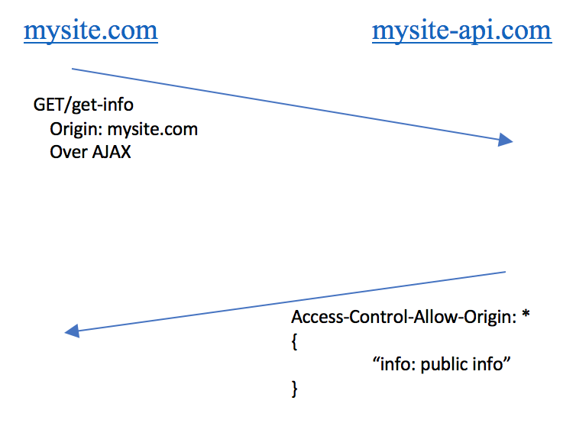
CORS Simple GET

Slide 27
Access Control Scenarios
Simple Request
  &
Preflight Request

Slide 28
About Simple Request
The only allowed methods are- GET, HEAD & POST
CORS-safelisted request-header
  Accept
  Accept-Language
  Content-Language
  Content-Type (but note the additional requirements below)
  Last-Event-ID
  DPR
  Save-Data
  Viewport-Width
  Width
Allowed Content-Type header are
  application/x-www-form-urlencoded
  multipart/form-data
  text/plain

Slide 29
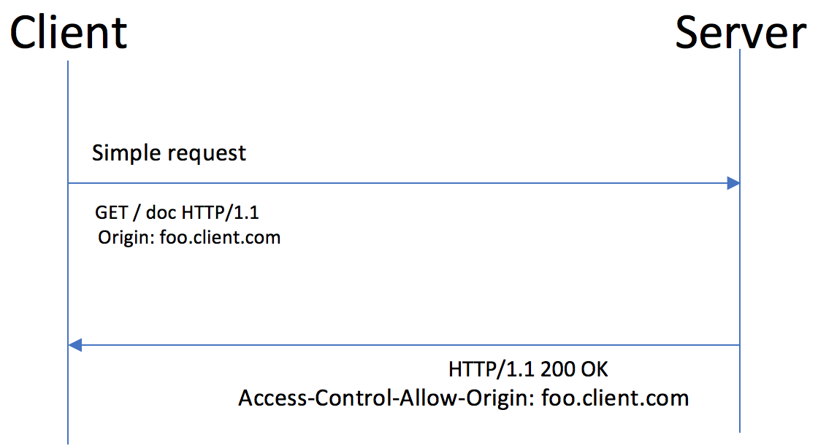
Example – CORS privileges simple request
foo.client.com >> Request >> bar.server.com
var invocation = new XMLHttpRequest();
var url = 'http://bar.server.com/greetings/';
function callOtherDomain() {
if(invocation) {
invocation.open('GET', url, true);
invocation.onreadystatechange = handler;
invocation.send();
}

Slide 30
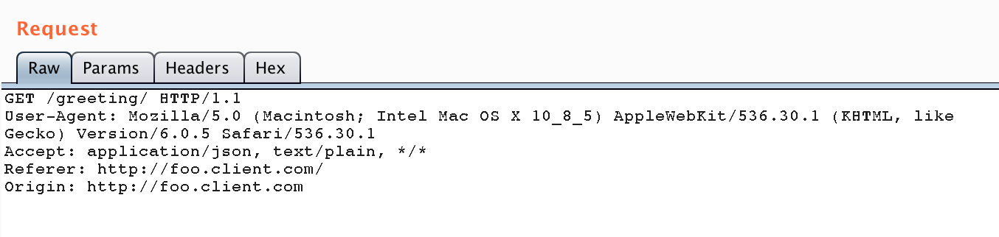
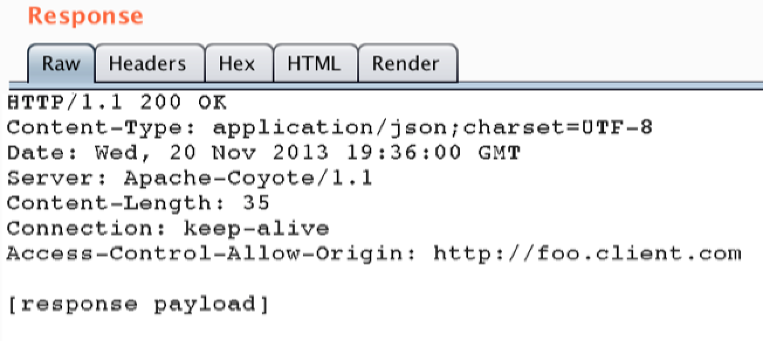
Request & Response
So the code will be like-
if($_SERVER[“HTTP_ORIGIN”] == “http://foo.client.com”)
{
header(“Access-Control-Allow-Origin: http://foo.client.com”);
}

Slide 31
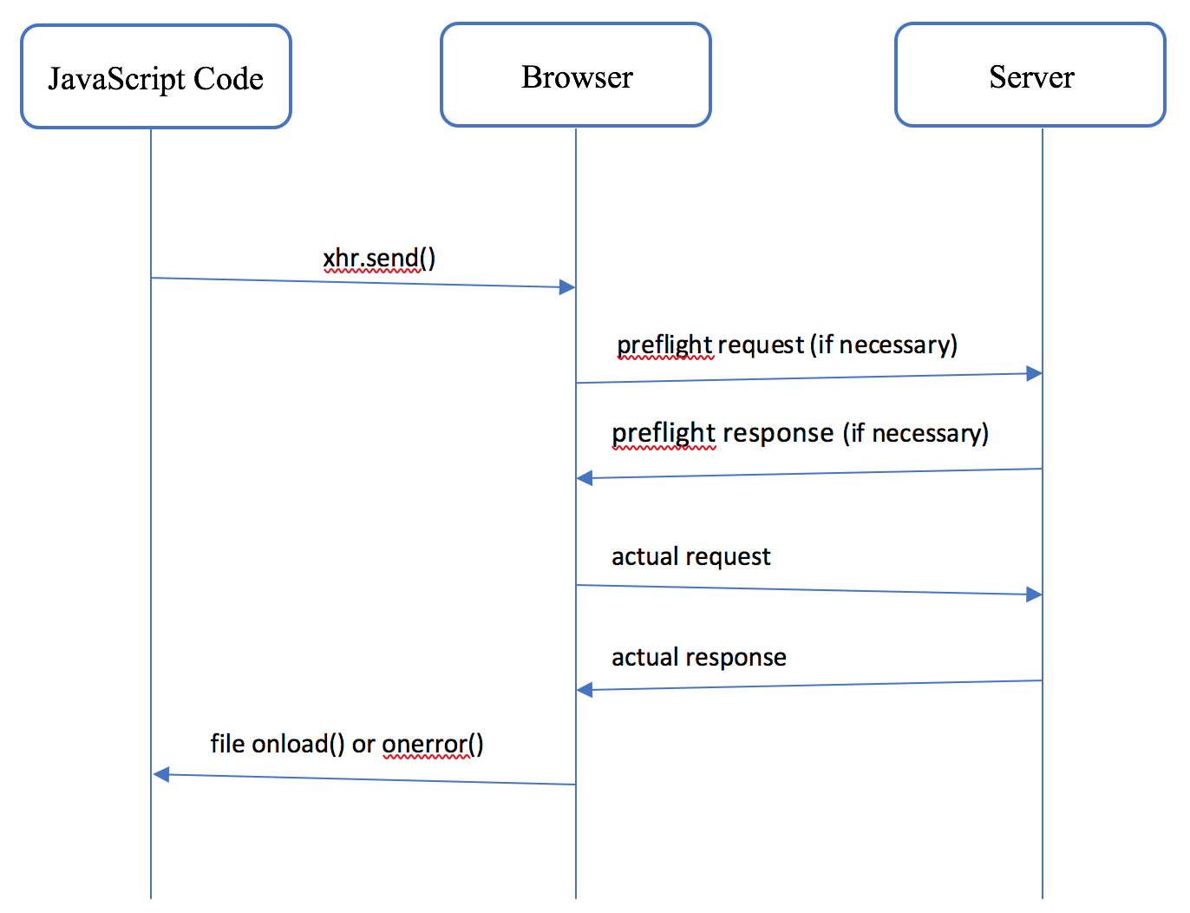
What about Not-So-Simple Request

Slide 32
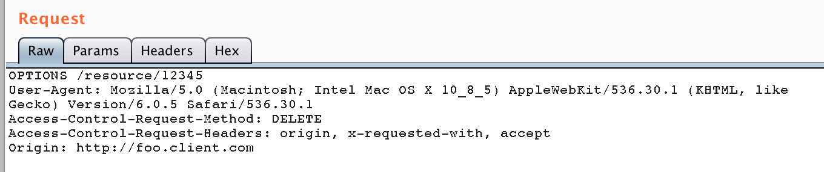
Preflight Request Model
For example, foo.client.com performs a DELETE request against bar.server.com. Preflight request takes the form of an OPTIONS request -

Slide 33
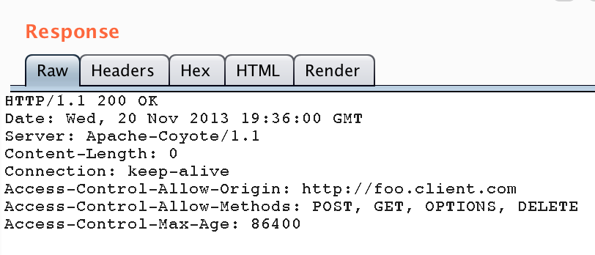
Preflight Response
Response to the preflight request indicates – Access-Control-Allow-Methods
Limitations with IE – IE >=10
Some javascript libraries, angularJS, Snotch by default supports to preflight requests only

Slide 34
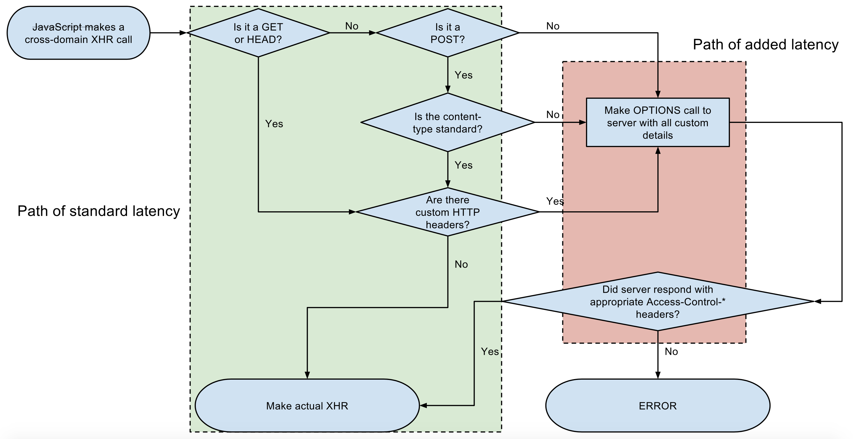
Check for Preflight Required?

Slide 35
Sending Cookies to cross domain using CORS
By default, CORS requests do not send or set cookies
Need to set the XHR - WithCredentials property to True
.withCredentials property sends and sets cookies from the remote domain

Slide 36
The HTTP request headers
Origin –
  Origin: <origin>
Access-Control-Request-Method –
  Access-Control-Request-Method: <method>
Access-Control-Request-Headers -
Access-Control-Request-Headers: <field-name>[, <field-name>]*
Access-Control-Allow-Credentials –
  Access-Control-Allow-Credentials: <true>
Access-Control-Max-Age –
  Access-Control-Max-Age: <delta-seconds>
Access-Control-Allow-Methods –
  Access-Control-Allow-Credentials: <true>

Slide 37
CORS Misconfiguration Test Cases
POOR Implementation, but BEST case for attack:
Access-Control-Allow-Origin: https://attacker.com
Access-Control-Allow-Credentials: true
POOR Implementation, but EXPLOITABLE:
Access-Control-Allow-Origin: null
Access-Control-Allow-Credentials: true
BAD Implementation, but not exploitable:
Access-Control-Allow-Origin: *
Access-Control-Allow-Credentials: true
or simply
Access-Control-Allow-Origin: *
Sometimes can’t exploit due to presence of customer header/unique/auth/key in URI

Slide 38
Security Concerns – CORS
OWASP mentioned Security Misconfiguration
Spoofing of origin header and server could leak out sensitive information
XSS, CSRF Protection bypass
Possible MitM due to CORS being enabled over the unencrypted HTTP protocol.

Slide 39
CSP
Content Security Policy

Slide 40
CSP – Content Security Policy
Developed by W3C
CSP - Instruct to client browser from which location and/or which type of resources are allowed to be loaded.
XSS Prevention - from which external locations is it allowed to load scripts, stylesheets or images? Is the browser allowed to load the website in an iframe from a different website?

Slide 41
Security Applications
Preventing cross site scripting
  Allows developers to restrict the sources of the script execution
  Mitigating packet sniffing attacks
  Server can specify which protocols are allowed to be used

Slide 42
How to set up CSP
Server configure with return - Content-Security-Policy HTTP header
Alternatively, the <meta> element can be used
For example: <meta http-equiv="Content-Security-Policy" content="default-src 'self'; img-src https://*; child-src 'none';">
Server can add Content-Security-Policy in response
  e.g. - Content-Security-Policy: default-src https://example.com *.example.com; script-src 'none'; frame-ancestors 'none'; block-all-mixed-content; report-uri /csp-violations/;

Slide 43
CSP Attributes
Multiple attributes can be defined in CSP header
Content-Security-Policy: <default-src><script-src ‘none’>
List of available headers,
https://developer.mozilla.org/en-US/docs/Web/HTTP/CSP

Slide 44
CSP Attributes
Below are some Important attributes -
default-src: this is the fallback for when other attributes have not been defined
script-src: restricts the locations external scripts can be loaded from.
img-src: restricts the locations images can be loaded from.
media-src: restricts the locations media (such as videos) can be loaded from.
object-src: restricts the locations plugins can be loaded from.
frame-ancestors: this attribute restricts the locations that may load the website using frame, iframe, object, embed or applet elements
form-action: restricts the URLs that can be used as part of a <form> action

Slide 45
Preventing Packet Sniffing
Can also be used to enforce - resources can only ever be loaded using HTTPS
by adding the https:// protocol to every value defined for the *-src attributes
The same effect can be achieved by adding the attribute block-all-mixed-content

Slide 46
Common Use Cases
1) A web developer wants all content to come from the site's own origin (this excludes subdomains)
Content-Security-Policy: default-src 'self’
2) Want to allow content from a trusted domain and all its subdomains
Content-Security-Policy: default-src 'self' *.trusted.com
3) Want to allow users of application to include images from any origin in their own content, but to restrict audio or video media to trusted providers
Content-Security-Policy: default-src 'self'; img-src *; media-src media1.com media2.com; script-src userscripts.example.com

Slide 47
Common Use Cases
4) A web developer for an online banking site wants to ensure that all its content is loaded using SSL, in order to prevent attackers from eavesdropping on requests.
Content-Security-Policy: default-src https://onlinebanking.jumbobank.com
5) Web developer of a web mail site wants to allow HTML in email, as well as images loaded from anywhere, but not JavaScript or other potentially dangerous content.
Content-Security-Policy: default-src 'self' *.mailsite.com; img-src *

Slide 48
Server side configuration
Apache Content-Security-Policy Header
Add the following to httpd.conf in VirtualHost or in an .htaccess file:
Header set Content-Security-Policy "default-src 'self';"
Nginx Content-Security-Policy Header
In server {} block add:
add_header Content-Security-Policy "default-src 'self';";
IIS Content-Security-Policy Header (in web.config file)
<system.webServer>
<httpProtocol>
<customHeaders>
<add name="Content-Security-Policy" value="default-src 'self';" />
</customHeaders>
</httpProtocol>
</system.webServer>

Slide 49
Reference
References:
  https://developer.mozilla.org/en-US/docs/Web/Security/Same-origin_policy
  https://developer.mozilla.org/en-US/docs/Web/HTTP/CORS
  https://developer.mozilla.org/en-US/docs/Web/HTTP/CSP
  https://www.owasp.org/

Slide 50
Future enhancement
Bypasses & Exploitation

Slide 51
Questions?
Thank you !

